Slide 1
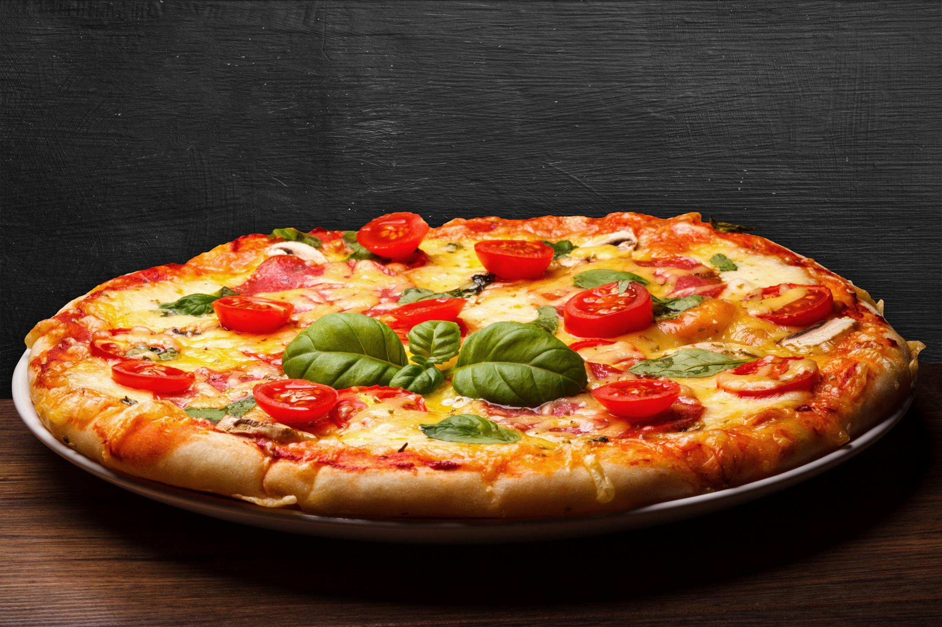
Pizza sales analysis based on sql

Slide 2




PROBLEM STATEMENT
To analyze the sales and revenue patterns of a pizza restaurant chain to optimize their menu offerings, pricing strategy, and operational efficiency. The analysis aims to identify key trends in order volumes, category performance, and revenue generation to support data-driven business decisions for growth and profitability.
Sub-problems to Address:
Category performance analysis (volume vs revenue)
Top selling pizzas along with quantity ordered creating impact on the overall revenue
Most selling pizzas sizes
Time-based ordering patterns
Product mix optimization
Revenue contribution analysis

Slide 3
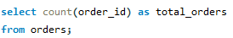
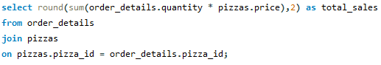
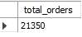
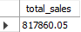
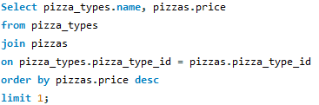
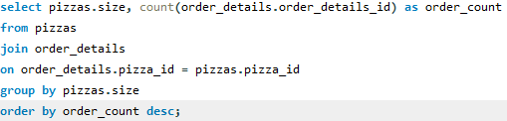
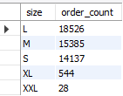
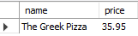
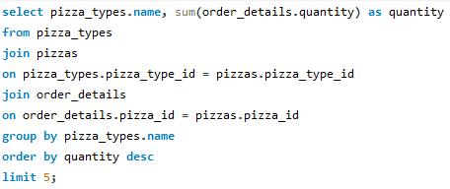
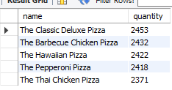
total number of orders placed
Total revenue generated from pizza sales
Highest priced pizza
MOST COMMON SIZE PIZZA ORDERED
top 5 most ordered pizza types along with their quantities

Slide 4
Analysis
Business Performance
Total Revenue: USD 817,860.05 from 21,350 orders
Category Mix: Balanced revenue distribution (23-27% per category)
Size Preference: L and M sizes dominate (34,111 combined orders). Large pizzas are the most popular size, suggesting that customers prefer larger portions, which likely contributes significantly to total revenue.
Product Pricing: The Greek Pizza is priced significantly higher, likely targeting premium customers.
Opportunities for Growth: Small and XXL pizzas have comparatively fewer orders. Promotions or bundle deals targeting these sizes could improve their sales.
Customer Preferences: Consistent demand across multiple pizza types and sizes reflects diverse customer preferences, emphasizing the need for variety in the menu.

Slide 5
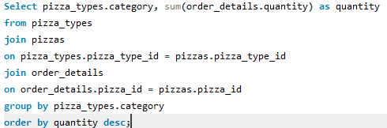
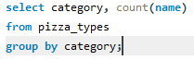
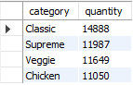
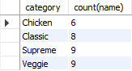
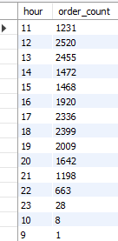
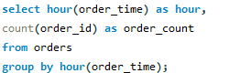
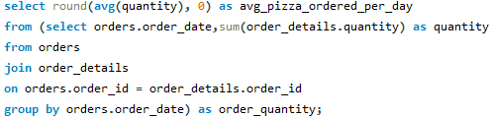
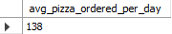
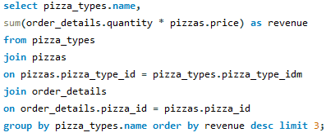
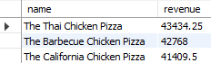
total quantity of each pizza category ordered
category-wise distribution of pizzas
distribution of orders by hour of the day
orders grouped by date and average number of
pizzas ordered per day
top 3 most ordered pizza types based on revenue

Slide 6
Analysis
Volume Leaders vs Revenue Leaders:
Classic category leads in order volume (14,888)
But Chicken pizzas (Thai, BBQ, California) dominate revenue generation
Product Performance: Classic category leads volume (14,888), while Chicken pizzas drive highest revenue per item
Daily Operations:
Average of 138 pizzas sold per day
Clear peak hours during lunch and dinner times
Menu Structure:
Supreme and Veggie (9 types) and Classic (8 types) offer most variety
Chicken has limited options (6 types)
Category Distribution:(by volume)
Supreme > Veggie > Classic > Chicken

Slide 7
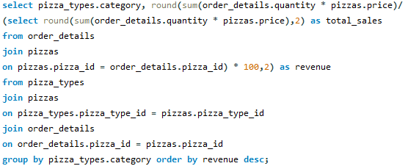
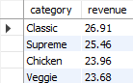
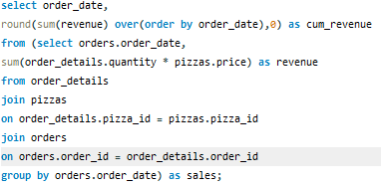
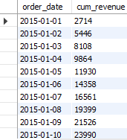
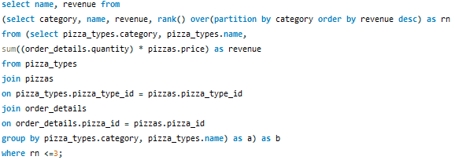
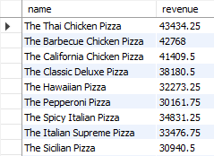
percentage contribution of each pizza type to total revenue
cumulative revenue generated over time.
most ordered pizza types based on revenue

Slide 8
Analysis
Revenue Metrics:
Categories: Even distribution (23-27% each), Classic leads at 26.91%
Top Performer: Thai Chicken Pizza (USD 43,434.25)
Growth: Cumulative Steady increase from USD 2,714 to USD 23,990 over 10 days
Key Insight:
While revenue distribution across categories is balanced, individual chicken-based pizzas generate highest per-item revenue, indicating successful premium pricing strategy despite lower volume sales.

Slide 9

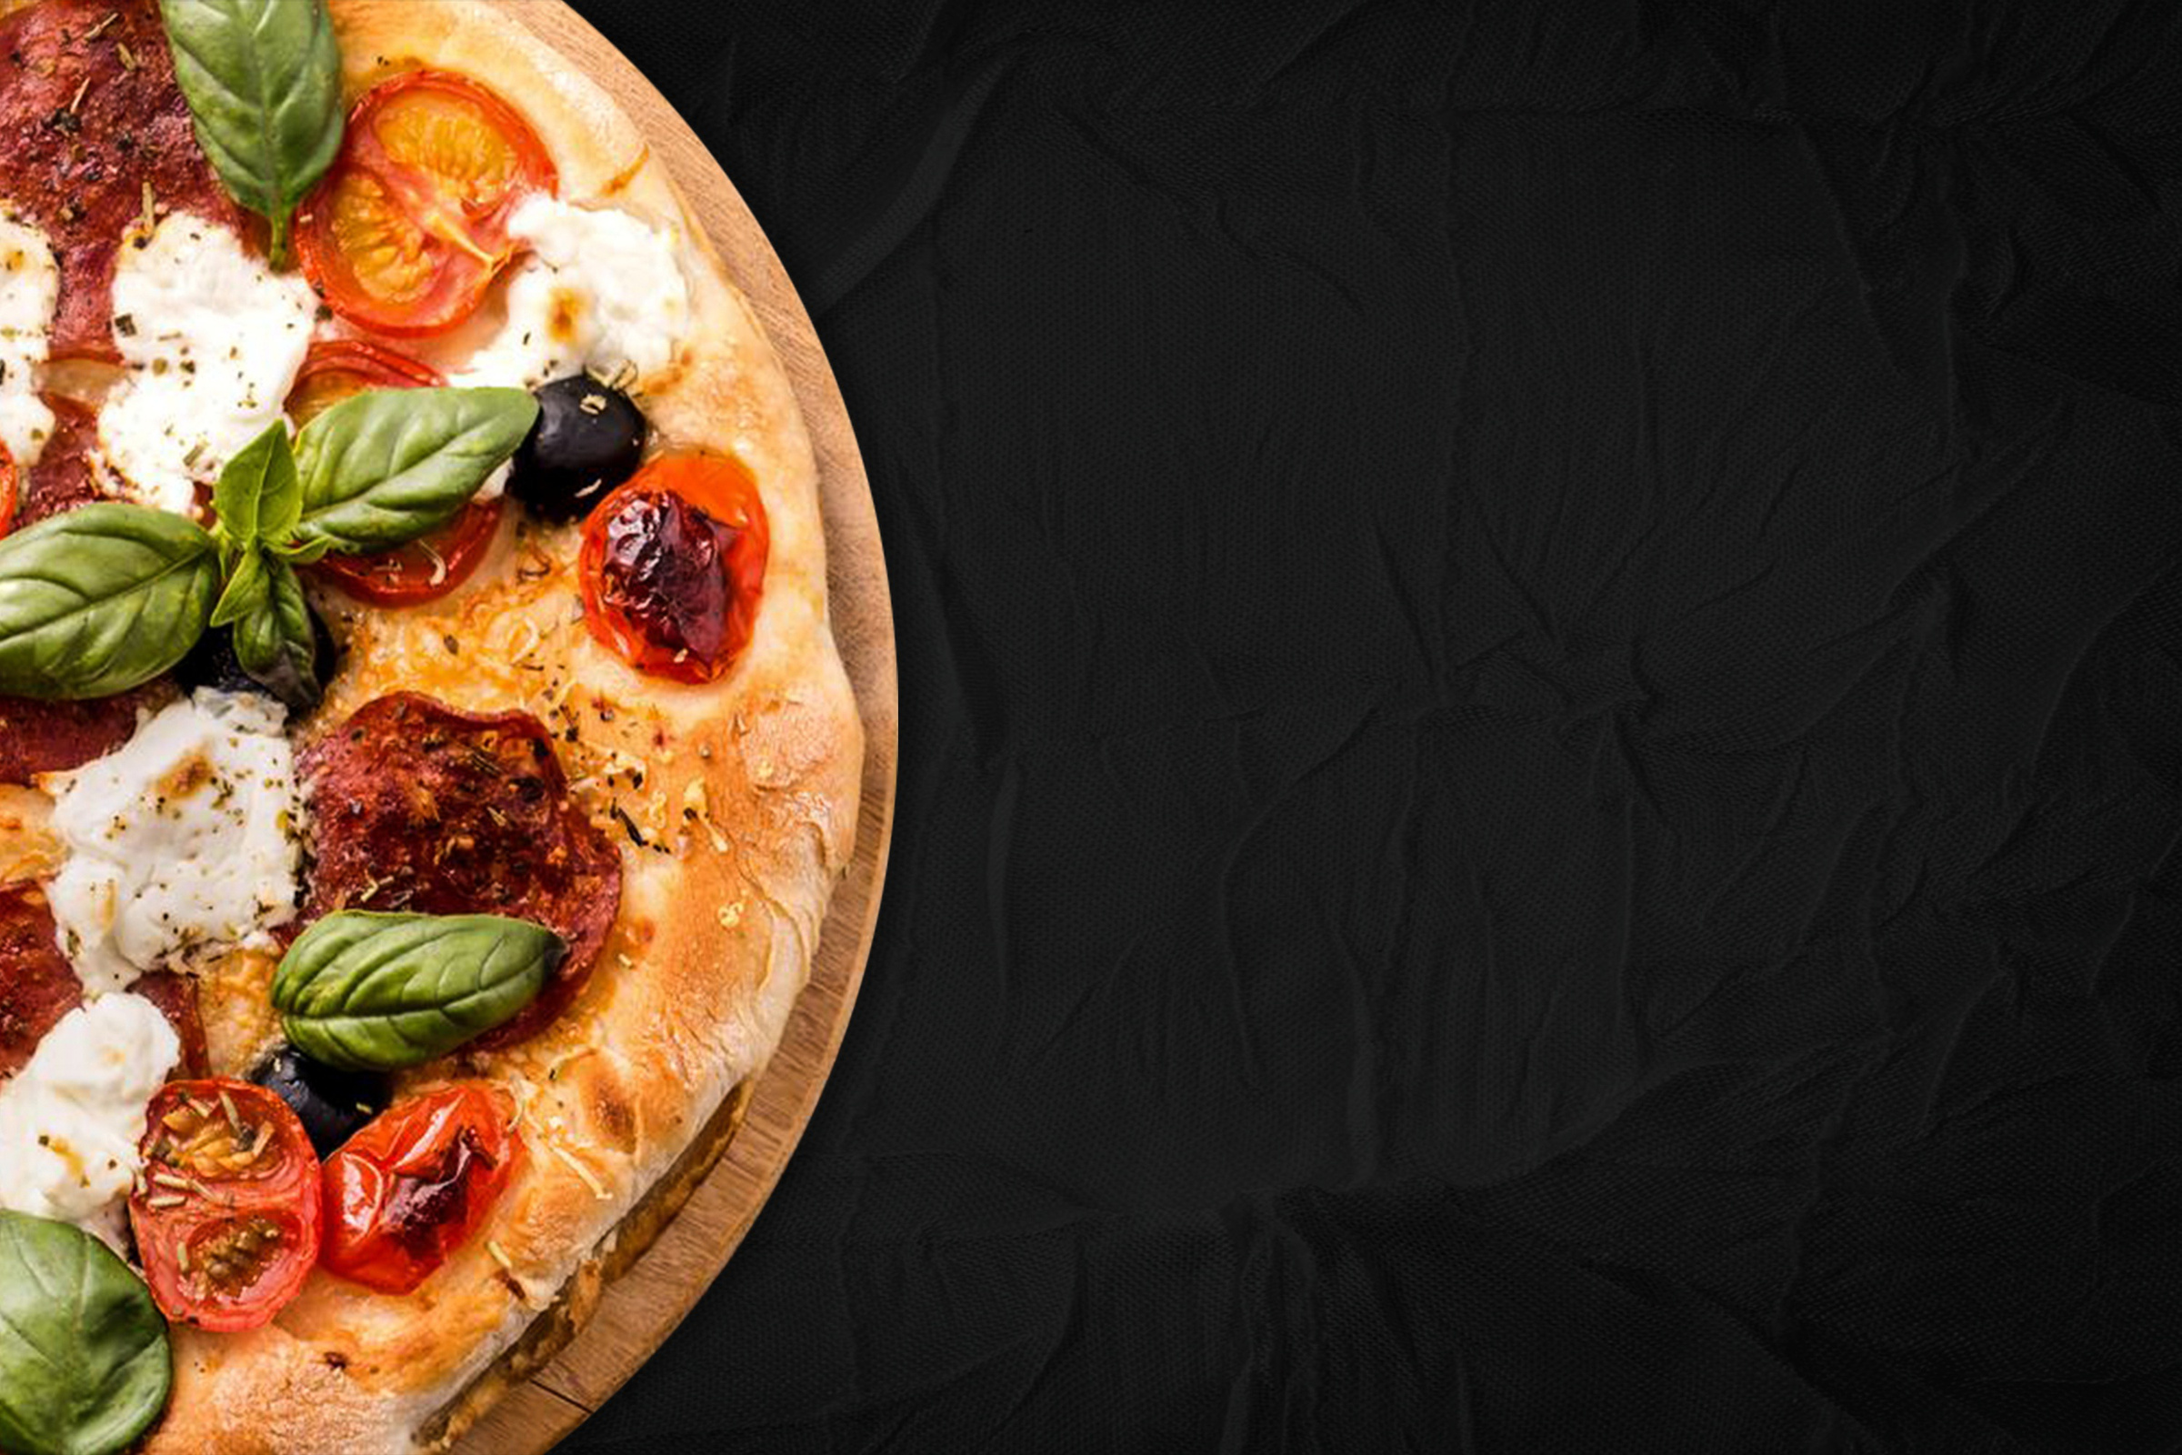
ThANK yOU

